Slide 1
Learning Process I Fitts & Posner
Calibration Clinic 2016 / 2017

Slide 2
Learning Process I Fitts & Posner (1967)
This learning process consists of three stages

Slide 3
Learning Process I Fitts & Posner (1967)
This learning process consists of three stages
Stages
of
Learning
Cognitive
Movement
Characteristics
slow
inconsistent
inefficient
frequent errors
calculated
lots of questions

Slide 4
Learning Process I Fitts & Posner (1967)
This learning process consists of three stages
Stages
of
Learning
Cognitive
Associative
Movement
Characteristics
slow
inconsistent
inefficient
frequent errors
calculated
lots of questions
improved performance
some inconsistency
more efficient
less questions

Slide 5
Learning Process I Fitts & Posner (1967)
This learning process consists of three stages
Stages
of
Learning
Cognitive
Associative
Autonomous
Movement
Characteristics
slow
inconsistent
inefficient
frequent errors
calculated
lots of questions
improved performance
some inconsistency
more efficient
less questions
accurate
smoother
consistent
efficient
less conscious thought
Source : 32 Degrees – Fall 2016; Kristen Quinn

Slide 6
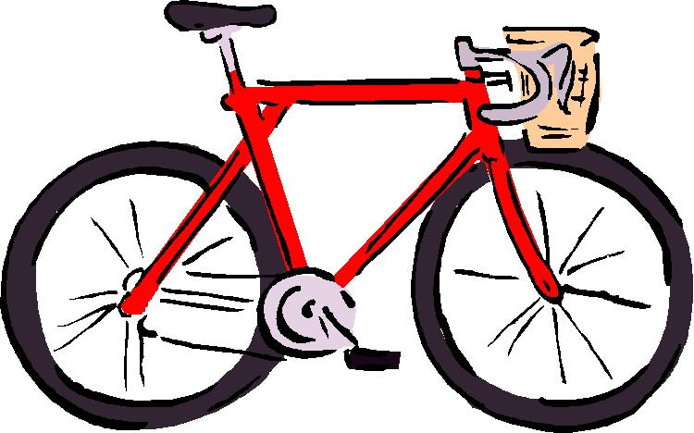
Learning Process I Easy as Riding a Bike
It’s as easy as riding a bike

Slide 7
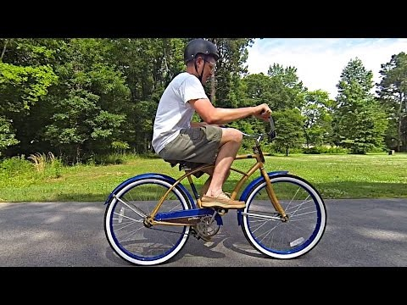
Learning Process I Easy as Riding a Bike
It’s as easy as riding a bike
The Backwards Brain Bicycle – Smarter Every Day 133 (YouTube video)

Slide 8
Learning Process I Backwards Brain Bicycle
Current riding skill
with standard steering
Cognitive
Associative
Autonomous

Slide 9
Learning Process I Backwards Brain Bicycle
Riding skill
with reverse steering
Current riding skill
with standard steering
Cognitive
Associative
Autonomous

Slide 10
Learning Process I Backwards Brain Bicycle
Riding skill
with reverse steering
Current riding skill
with reverse steering
Cognitive
Associative
Autonomous
A slight change of a Motor Skill translates into an 8 month process to return to an Autonomous skill stage

Slide 11
Learning Process I Appling the Process to Skiing - Tail Person on the Toboggan
Task : Pivot Slip
Cognitive
Associative
Autonomous

Slide 12
Learning Process I Appling the Process to Skiing - Tail Person on the Toboggan
Task : Pivot Slip
Widen Stance
Cognitive
Associative
Autonomous

Slide 13
Learning Process I Appling the Process to Skiing - Tail Person on the Toboggan
Task : Pivot Slip
Widen Stance
Cognitive
Associative
Autonomous
Balance over Skis

Slide 14
Learning Process I Appling the Process to Skiing - Tail Person on the Toboggan
Task : Pivot Slip
Open up Hips
Widen Stance
Cognitive
Associative
Autonomous
Balance over Skis

Slide 15
Learning Process I Appling the Process to Skiing - Tail Person on the Toboggan
Task : Pivot Slip
Hands in Front
Open up Hips
Widen Stance
Cognitive
Associative
Autonomous
Balance over Skis

Slide 16
Learning Process I Appling the Process to Skiing - Tail Person on the Toboggan
Task : Pivot Slip
Hands in Front
Open up Hips
Widen Stance
Cognitive
Associative
Autonomous
Look Down the Hill
Balance over Skis

Slide 17
Learning Process I Appling the Process to Skiing - Tail Person on the Toboggan
Task : Pivot Slip
Turn w/ Lead
Hands in Front
Open up Hips
Widen Stance
Cognitive
Associative
Autonomous
Look Down the Hill
Balance over Skis

Slide 18
Learning Process I Appling the Process to Skiing - Tail Person on the Toboggan
Task : Pivot Slip
What about the TAIL ROPE
& the upper part of the body?
Turn w/ Lead
Hands in Front
Open up Hips
Widen Stance
Cognitive
Associative
Autonomous
Look Down the Hill
Balance over Skis

Slide 19
Learning Process I Appling the Process to Skiing - Tail Person on the Toboggan
Task : Learning / Relearning how to Manage the Tail Rope
Sr. Candidate –
current tail rope skill level
Cognitive
Associative
Autonomous
Alpine Candidate –
current tail rope skill level

Slide 20
Learning Process I Appling the Process to Skiing - Tail Person on the Toboggan
What is the probability of success when learning two tasks at the same time and both are in the Cognitive and/or Associative Stages?
Sr. Candidate –
current tail rope skill level
Turn w/ Lead
Hands in Front
Open up Hips
Widen Stance
Cognitive
Associative
Autonomous
Look Down the Hill
Balance over Skis
Alpine Candidate –
current tail rope skill level

Slide 21
Learning Process I Coaching Points
Video feedback is a positive means to accelerate the learning process
Source : 32 Degrees – Fall 2016; Kristen Quinn

Slide 22
Learning Process I Coaching Points
Video feedback is a positive means to accelerate the learning process
Stages
of
Learning
Cognitive
Coaching Points
immediate feedback
clear explanations
single focus
plenty of practice time
accurate demos
Source : 32 Degrees – Fall 2016; Kristen Quinn

Slide 23
Learning Process I Coaching Points
Video feedback is a positive means to accelerate the learning process
Stages
of
Learning
Cognitive
Associative
Coaching Points
immediate feedback
clear explanations
single focus
plenty of practice time
accurate demos
intrinsic feedback
less immediate
motivation
encouragement
plenty of practice time
Source : 32 Degrees – Fall 2016; Kristen Quinn

Slide 24
Learning Process I Coaching Points
Video feedback is a positive means to accelerate the learning process
Stages
of
Learning
Cognitive
Associative
Autonomous
Coaching Points
immediate feedback
clear explanations
single focus
plenty of practice time
accurate demos
intrinsic feedback
less immediate
motivation
encouragement
plenty of practice time
continue to monitor
expand skills via steeper terrain, variable conditions
refinement
Source : 32 Degrees – Fall 2016; Kristen Quinn

Slide 25
Learning Process I Improving the Learning Process to Drive Success
Candidate
Be patient with the process
Practice with exploratory learning

Slide 26
Learning Process I Improving the Learning Process to Drive Success
Candidate
Coach
Be patient with the process
Practice with exploratory learning
Use the Skiing Fundamentals
Progressions towards a desired outcome

Slide 27
Learning Process I Improving the Learning Process to Drive Success
Candidate
Alignment between both the Candidate and the Coach on the location along the Learning Stage is critical to a positive outcome
Coach
Be patient with the process
Practice with exploratory learning
Use the Skiing Fundamentals
Progressions towards a desired outcome

Slide 28
Learning Process I Skiing Fundamentals
Fundamentals | Skill Drill : Level 1 | Skill Drill : Level 2 | Skill Drill : Level 3
Balance Control the relationship of the Center of Mass (COM) to the Base of Support (BOS) through direct pressure along the length of the ski | Forward Sideslip | Falling Leaf | Lane Change / One Ski
Rotational Control Control the skis rotation with leg rotation separate from the upper body | Hockey Stop (green terrain) | Open Parallel, no poles; Garlands | Pivot Slips
Edge Control Control edge angles through a combination of inclination and angulation | Step out of diagonal traverse to a stop | Skate down a fall line and RR Tracks | 1,000 Step Turns
Pressure Control Control pressure from ski to ski and direct pressure to the outside ski | Uphill Christie; Inside ski lift after turn initiation | Basic Leapers; RR Tracks; Step Turns | Short Radius Turns
Pressure Control Regulate the magnitude of pressure created through ski/snow interaction | Straight run with a hop | Stem Christie; Pivot Slips in the bumps | Simultaneous Hop Turns in the bumps; Short/Long Radius Carved Turns
Source : NSP.ORG; Jim O’Conner

Slide 29
Learning Process I Fitts & Posner
Calibration Clinic 2016 / 2017

